Slide 1


Social Buzz Data Analysis
Presented by Sophia Umukoro

Slide 2


Today's agenda
Project recap
Problem
The Analytics team
Process
Insights
Summary

Slide 3

Social Buzz is a fast-growing technology unicorn that need to adapt quickly to its global scale. Accenture is running a 3-month project focusing on these tasks:
An audit of their big data practice
Recommendations for a successful IPO
Analysis of their content categories
Project Recap

Slide 4

Problem
Over 100000 posts a day
36500000 posts per year!!!
With very shallow idea on how to capitalize :(

Slide 5


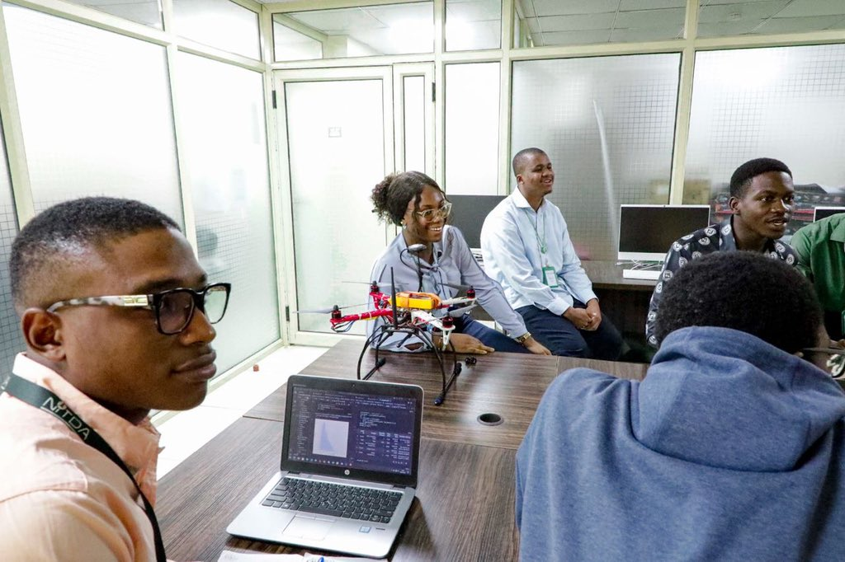
ANDREW FLEMING
Chief Technology Architect
The Analytics team
MARCUS ROMPTON
Senior Principal
SOPHIA UMUKORO
Data Analyst

Slide 6
Process
1
Data Understanding
Data Cleaning
2
Data Modeling
3
Data Analysis
4
Uncover Insights
5

Slide 7

Insights
16
Unique Categories
1897
Reactions to “Animal” Content
MAY
Most
Active
Month

Slide 10

ANALYSIS
Animals and science are the two most popular content categories, showing that people enjoy real-life" and "factual" content the most.
INSIGHT
Food is a common theme in the top 5 categories, with "Healthy Eating" ranking the highest. This may indicate the audience within your user base. You could use this insight to create a
campaign and work with healthy eating brands that boost user engagement
NEXT STEPS
This ad-hoc analysis is insightful, but it’s time to take
This analysis large scale production for real-time
Summary

Slide 11
Thank you!
ANY QUESTIONS?

